Slide 1


Slide 2
Chair’s Report
“State of the District”

Slide 3
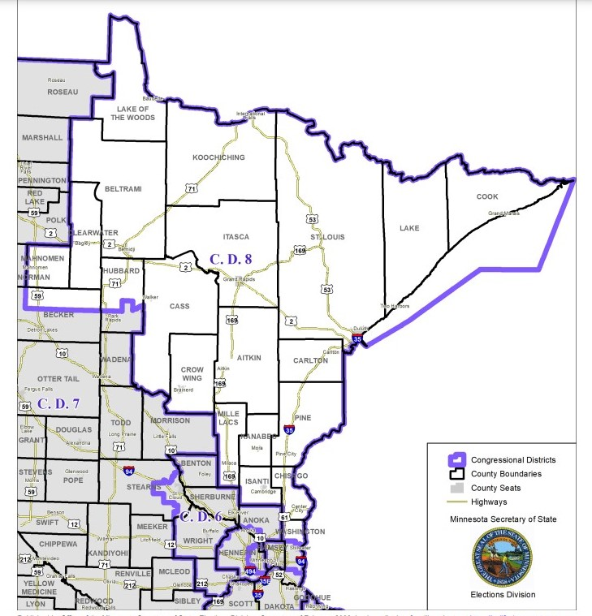
You are here!
Welcome to Crow Wing County!
Notes:
Thank you for coming to Cragun’s today - Thank Dutch.

Slide 4
Objective:
“To facilitate the election of a Republican Congressman or Congresswoman to represent the people of the Eighth District and to manage the affairs of the party within the District, remembering always that in order to govern, the Republican candidates must first win elections.”
–CD8 Constitution
Notes:
Our main objective is the elect a Republican to the US House!

Slide 5
Notes:
Congressman Stauber is the Chairman of the sub-committee on Energy and Mineral Resources and we are so proud to have him representing us in Washington!

Slide 6
14.46%
The LARGEST victory margin yet
for Congressman Stauber
Notes:
This is the largest point-spread since Pete ran for the first time in 2016. (Before that, Stewart Mills only lost by 1005 votes!)

Slide 7
ALL 21
Counties in CD8 got MORE Republican
Notes:
Each county had more Republicans hit the polls. Thank you to Suzanna for doing the post-election data analysis!

Slide 8
29,391
More Republican voters turned out
in 2022 as compared to 2018 in CD8

Slide 9
1944
The last time HD11A, HD3B, HD3A
and SD7 were REPUBLICAN…until 2022
Notes:
In 1944 Farmer-Laborer party meshed with the Democrat Party and created a monopoly against Republicans and I am happy to report that for the first time in 89 years, these districts flipped!

Slide 10
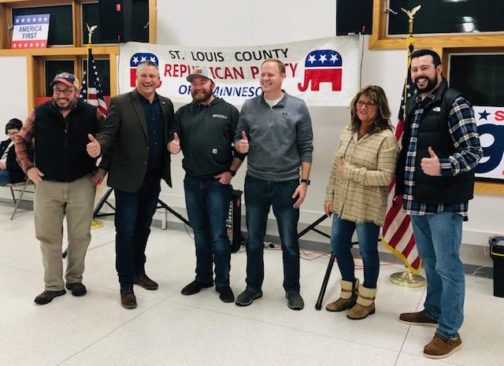
Notes:
These candidates here are the rockstars, Roger Skraba, Jeff Dotseth, Matt Norri, Rob Farnsworth, Andrea Zupancich and Spencer Igo. Not all of them made it through but the two that didn't, less than 588 votes stopped them from representing us. When we talk about getting people out to vote - we aren't talking massive numbers. 236 for Norri, 352 for Andrea and 899 for Mark Bishofsky for a total of 1,487 – Razor Thin Margins!

Slide 11

Get Out the Vote
Notes:
236 for Norri, 352 for Andrea and 899 for Mark Bishofsky for a total of 1,487 – Razor Thin Margins!

Slide 12
Can we chase ballots like the Democrats?
Would it make a difference?
Notes:
236 for Norri, 352 for Andrea and 899 for Mark Bishofsky for a total of 1,487 – Razor Thin Margins!

Slide 13
1,487
Between 7B, SD3 & 33B
100 people could chase 15 ballots each and we can win these!
Notes:
236 for Norri, 352 for Andrea and 899 for Mark Bishofsky for a total of 1,487 – Razor Thin Margins!

Slide 14
7,710
House 3A and 3B - Duluth
100 people could chase 77 ballots each and we can win these!
Notes:
236 for Norri, 352 for Andrea and 899 for Mark Bishofsky for a total of 1,487 – Razor Thin Margins!

Slide 15
What is possible with the right volunteers?

Slide 16

11,242
Calls made by CD8 volunteers!
Notes:
Char orchestrated numerous phone backs for CD8. Voter contacts when you can speak to a real person are incredibly valuable.

Slide 17
Doors Knocked
2,353 by CD8 volunteers
85,133 by staff & candidates
Notes:
There is a lot of crossover between the “volunteer” accounts and the “staff/candidate” accounts.

Slide 18

$1,500,000
Was spent against Rep. Natalie Zeleznikar - one house candidate…
And she still won!

Slide 19
The DFL is spending more than Republicans per vote which means Republican donations
GO FARTHER

Slide 20
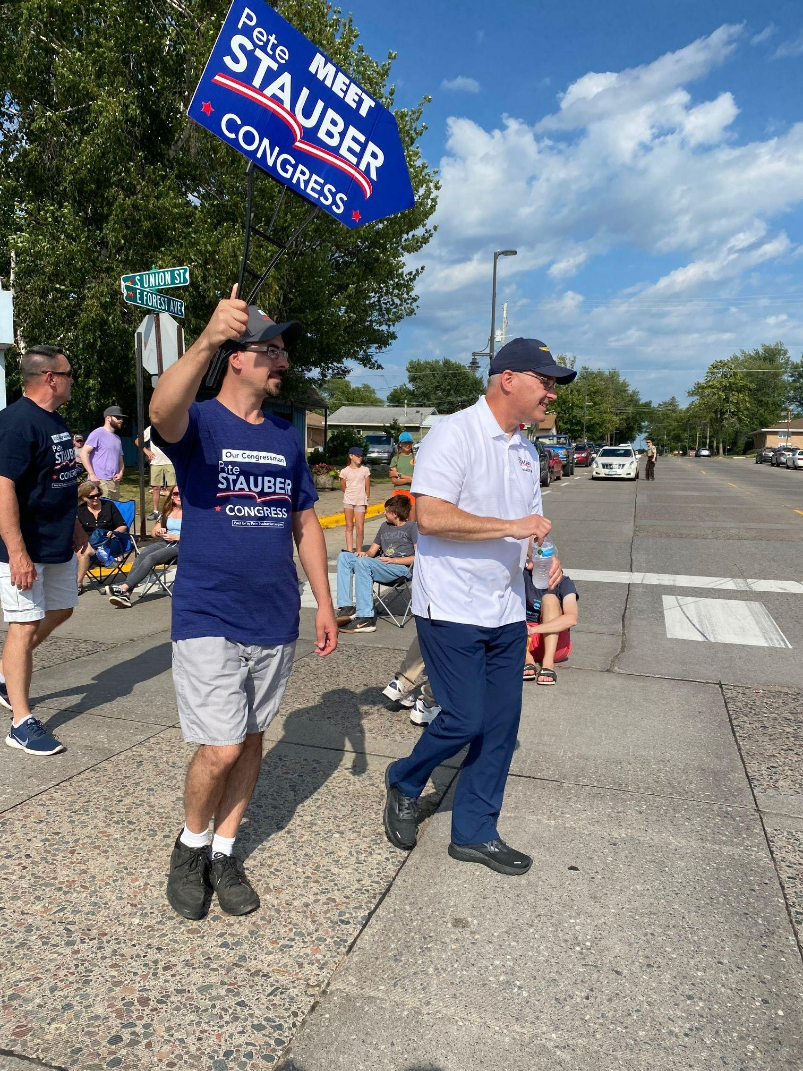
Dozens of parades
walked
Notes:
Eric Langness, Pete’s Runner

Slide 21
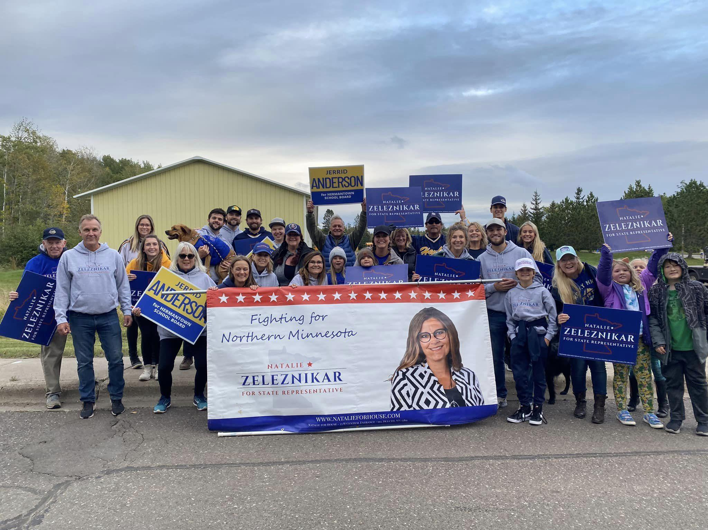
Notes:
Hermantown, Natalie

Slide 22

49,609
Communications (Emails) Sent from CD8
Notes:
We needed better communication and you got it.

Slide 23
156
Candidate, campaign, and BPOU events promoted
Notes:
We use a software interface called Buzz360 which is Republican owned and an approved vendor of the RNC (There’s my commercial) and with that, we can promote and track events. Every campaign and BPOU knew they could send us their events for promotion.

Slide 24
CD8 must GOTV relentlessly to pick up votes that will offset the extreme margin in the metro.
2024 Goals:
Increase MN08 GOP Margin
Pick Up HD7B & HD33B
Increase HD8A/B Voter Turnout by 6%
2026 Goal:
Pick Up SD3
Notes:
Per the state party, we must make up for losses in the cities.

Slide 25
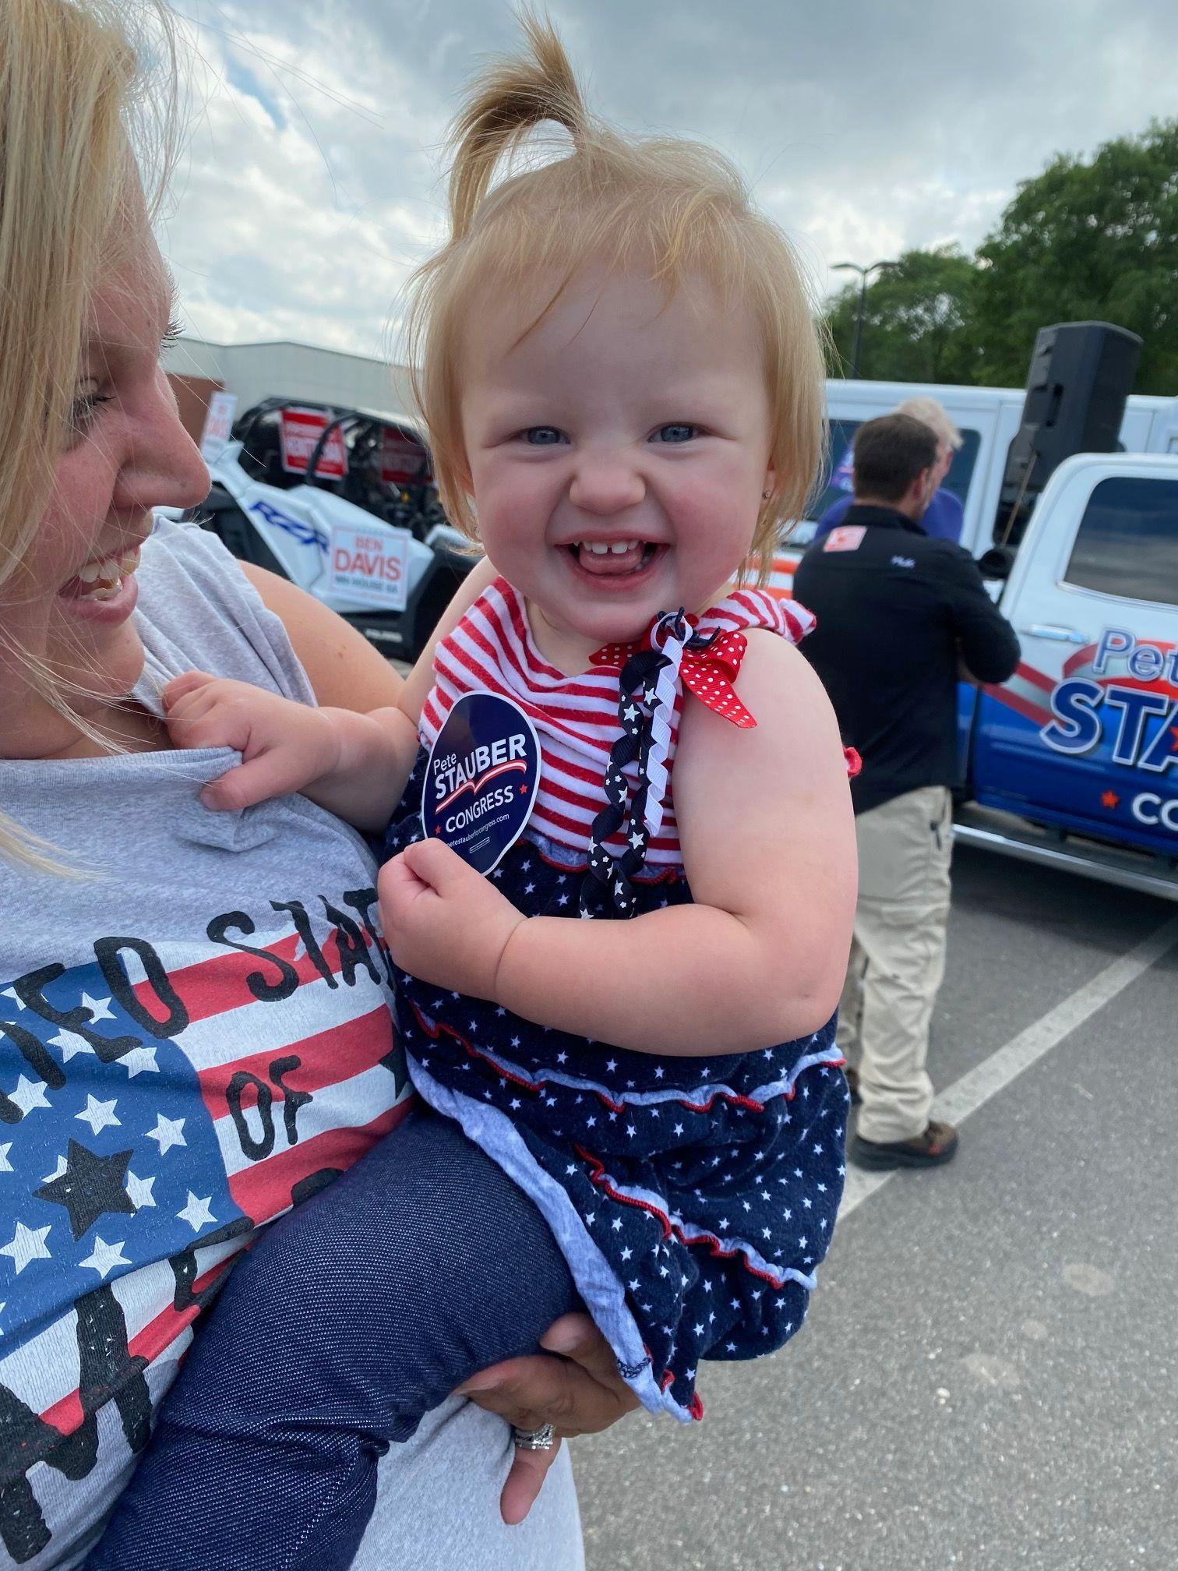
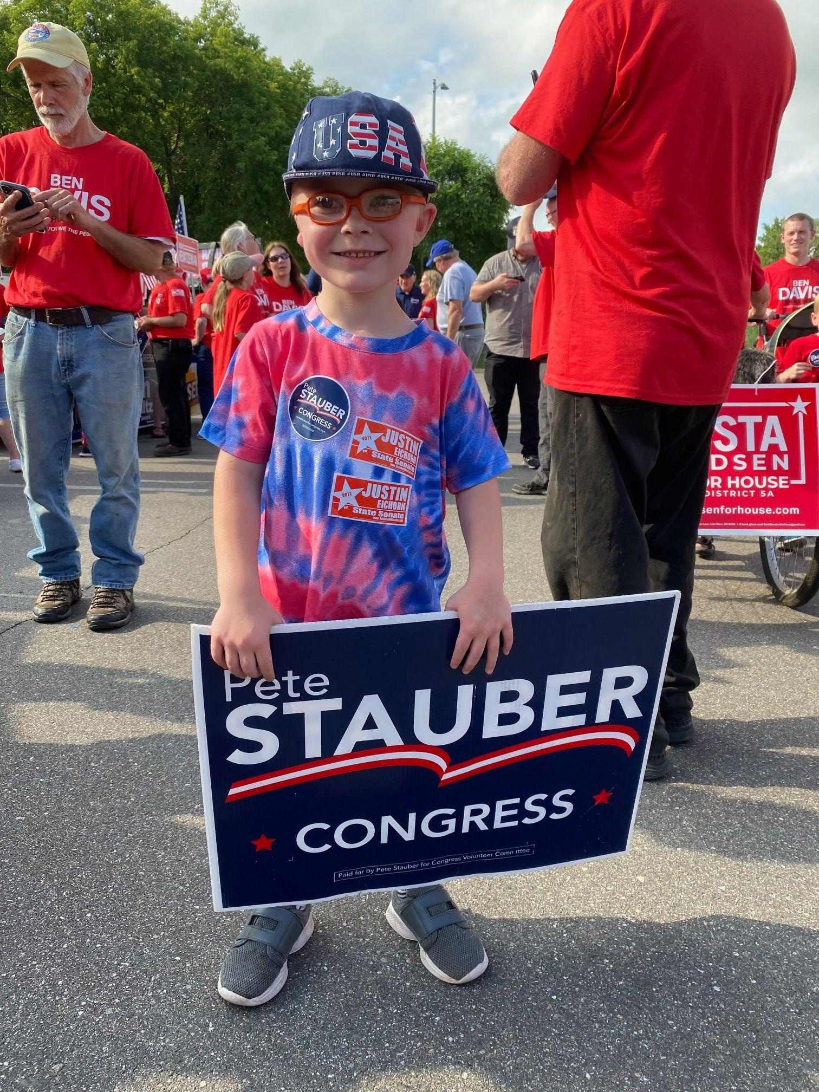
Notes:
Zoie and Joshua, this is the generation we are working for!

Slide 26
CD8 Produced Results
…wait to see what we can do in TWO years!

Slide 27
Thank you to each an every candidate, campaign team, donor and volunteer! We could not be successful without you!

Slide 28
To volunteer with the
Crow Wing County Republicans
please contact Donna Winge at
dwrep2021@yahoo.com

Slide 29
Contact Us!
info@mncd8gop.com
www.mncd8gop.com
Facebook.com/MN08GOP

